Slide 1

Notes:
Slide 1: Title

Slide 2
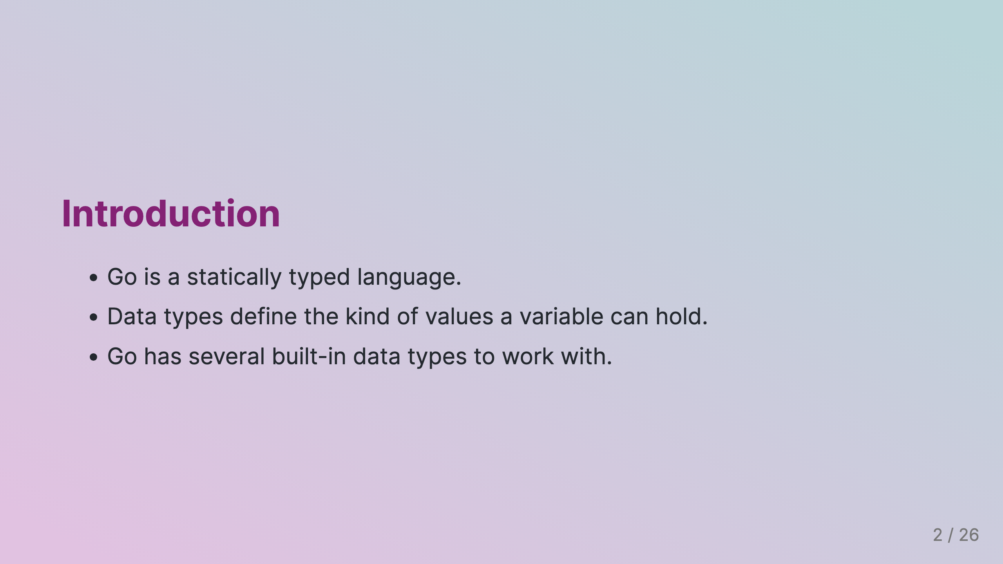
Notes:
Slide 2: Introduction

Slide 3
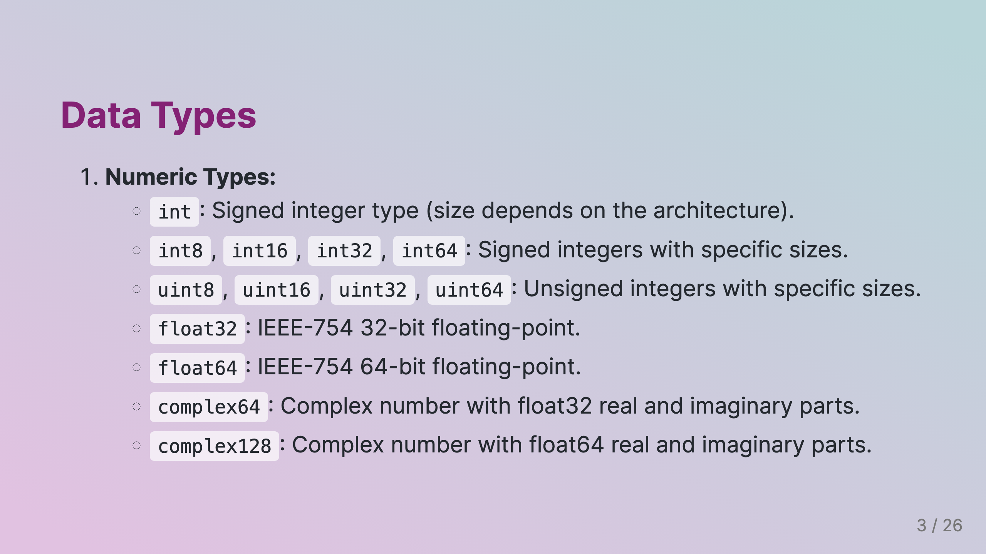
Notes:
Slide 3: Numeric Data Types

Slide 4
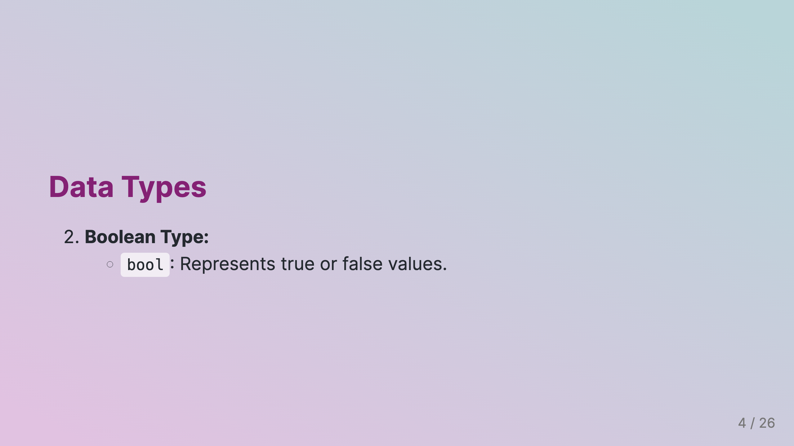

Slide 5
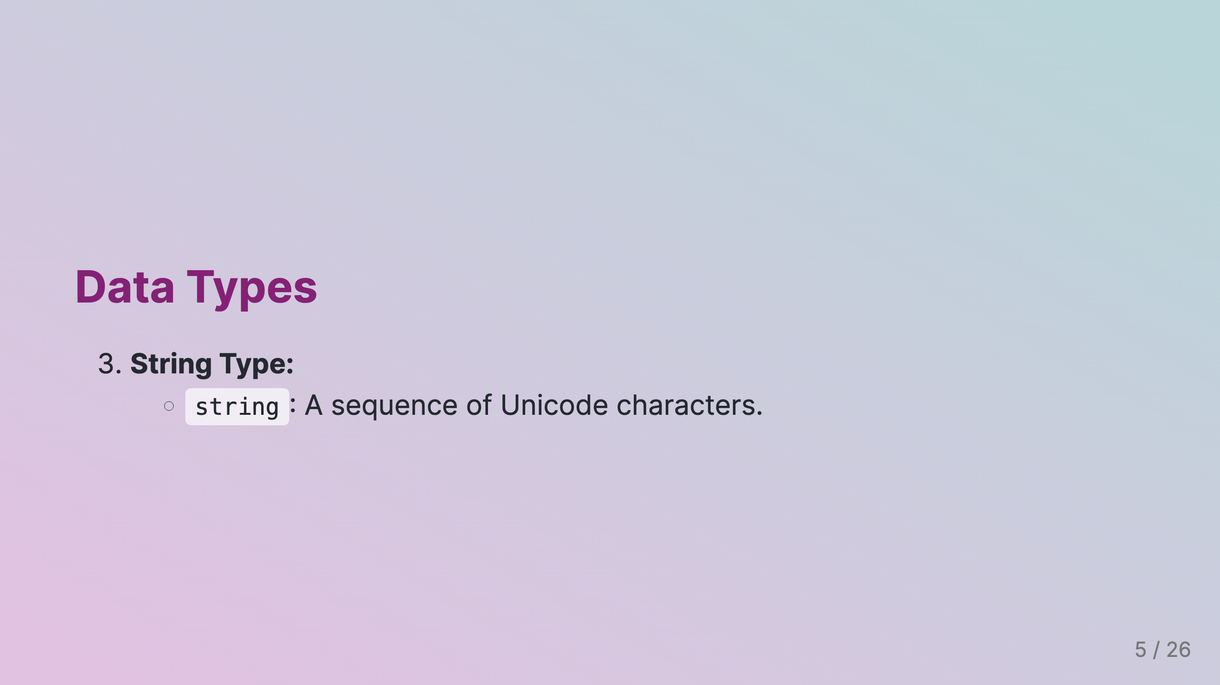

Slide 6
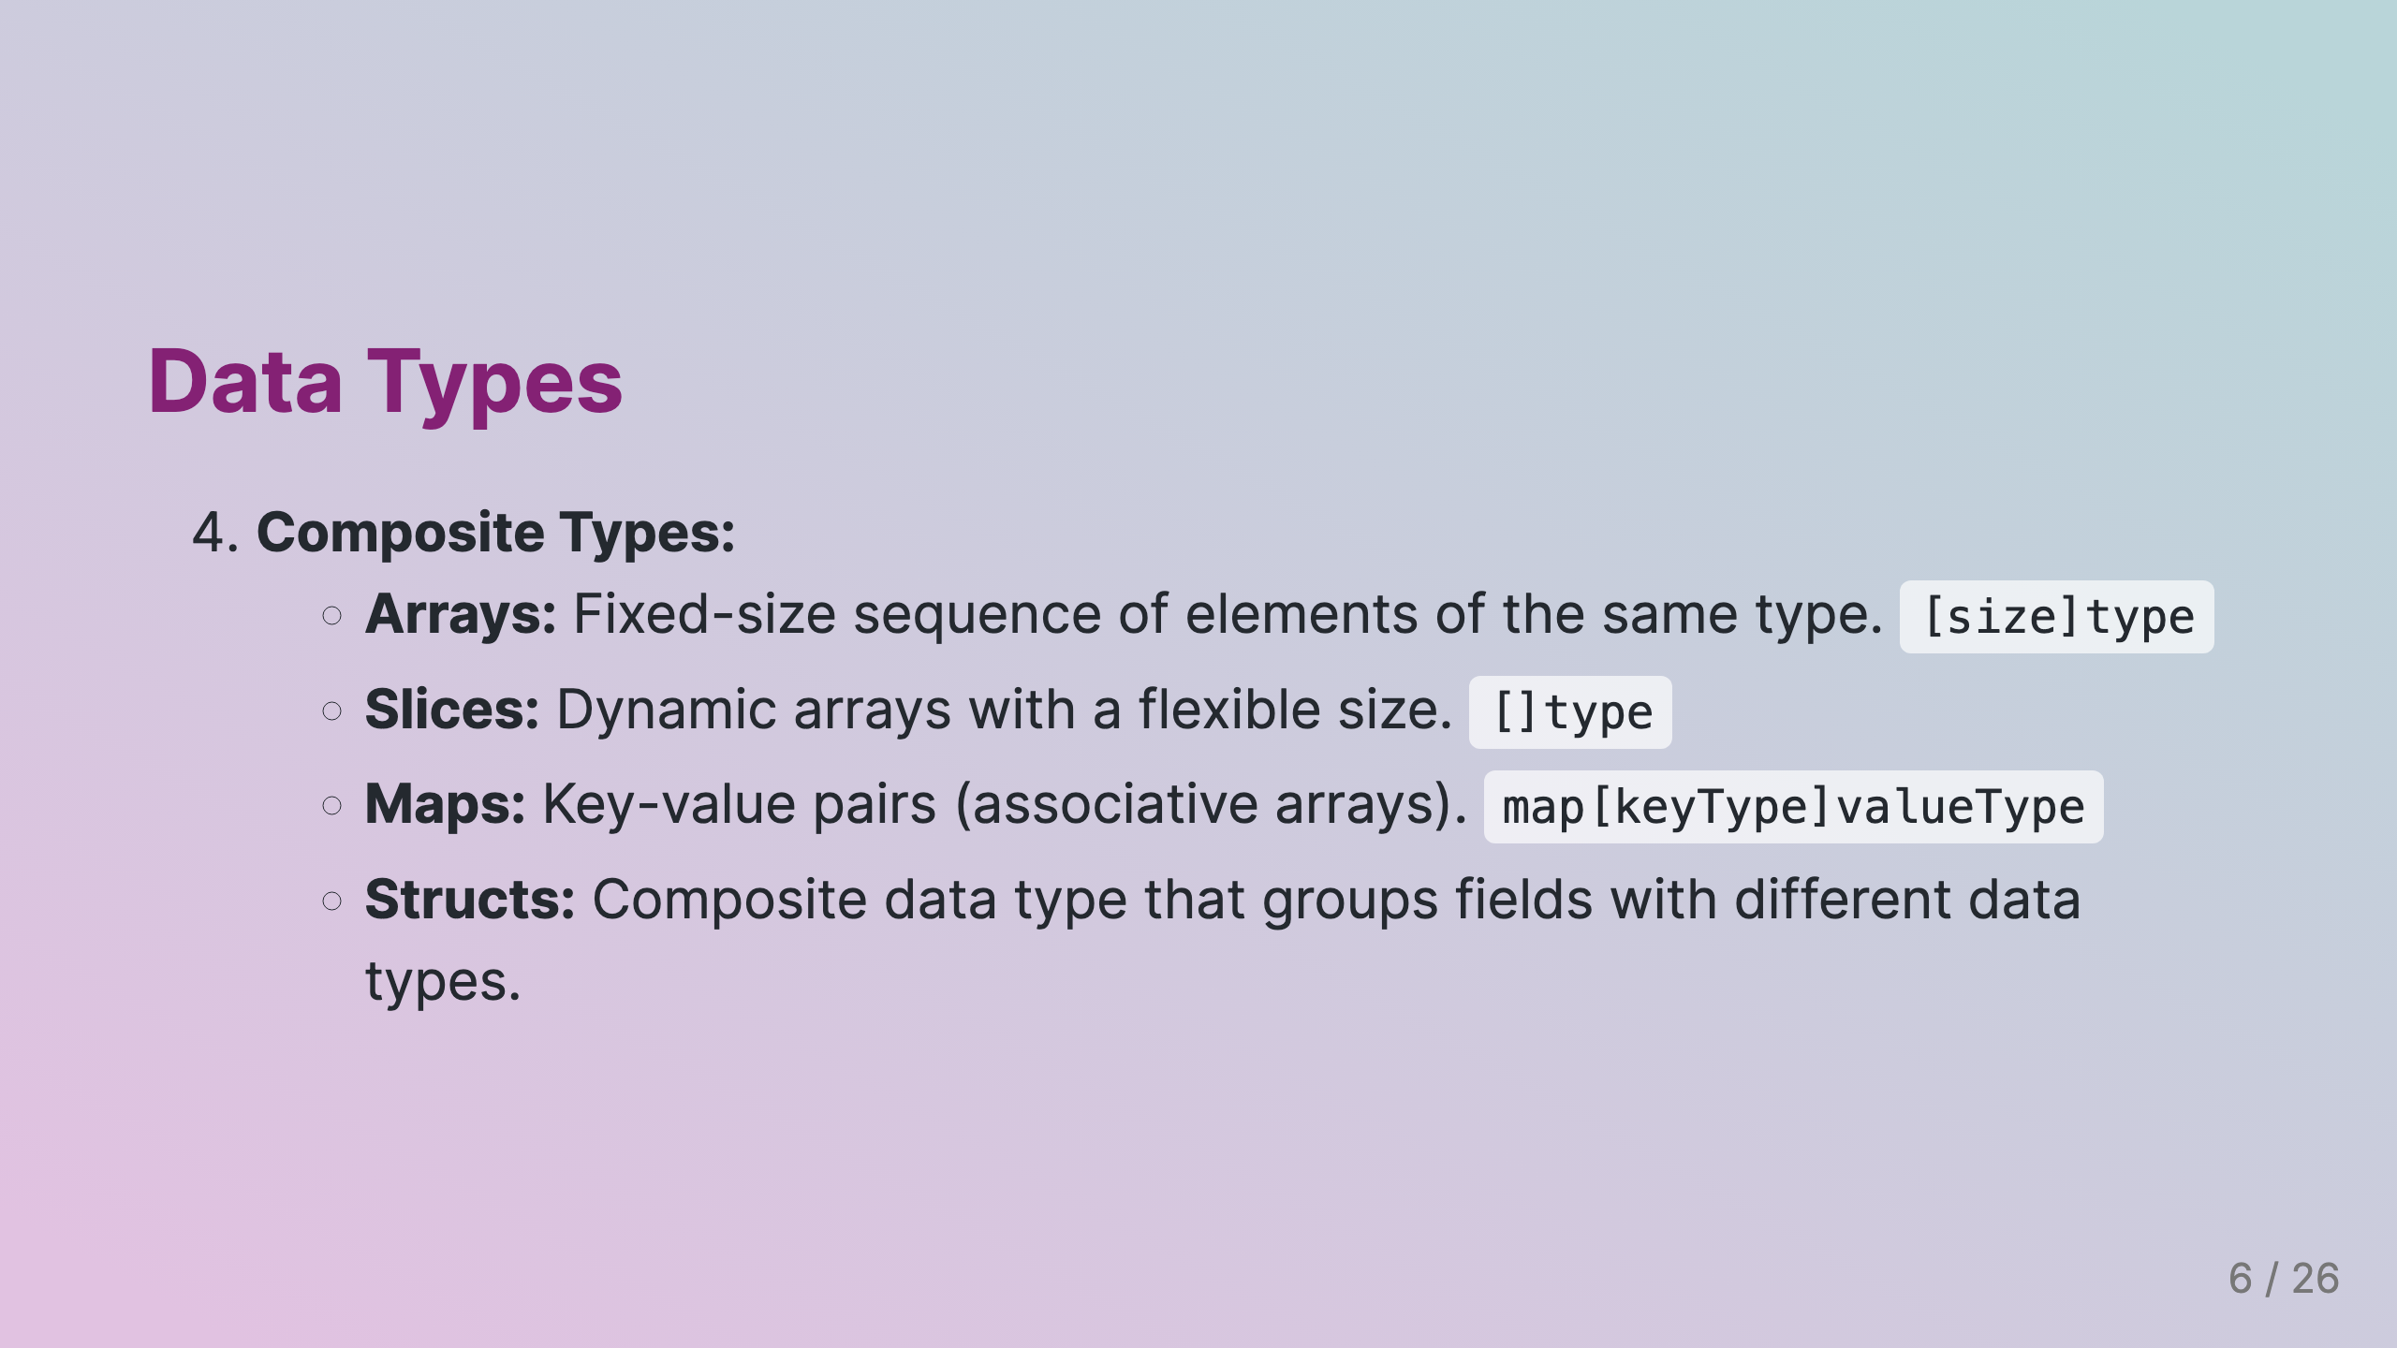

Slide 7
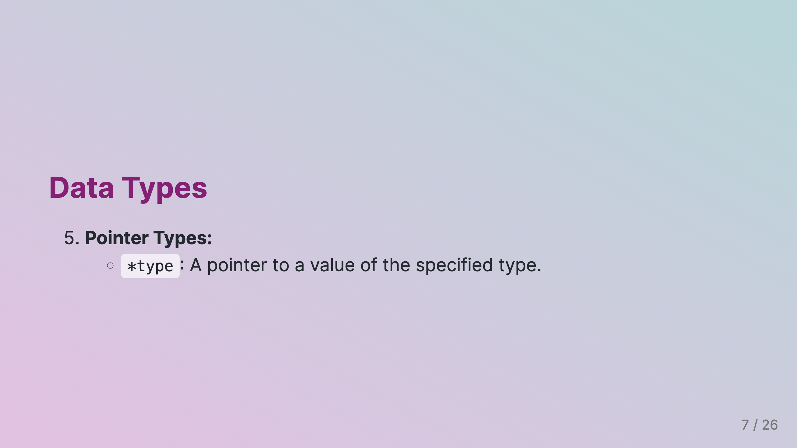

Slide 8
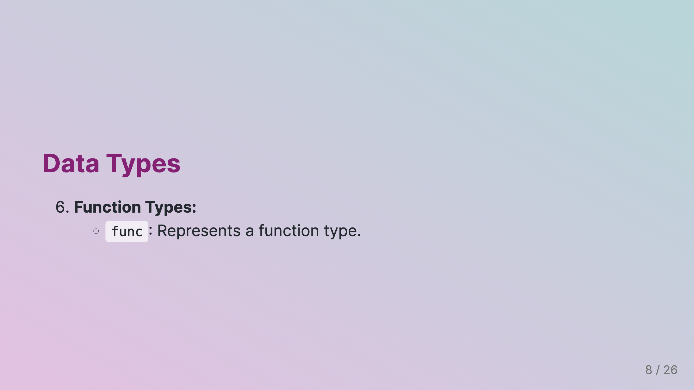

Slide 9
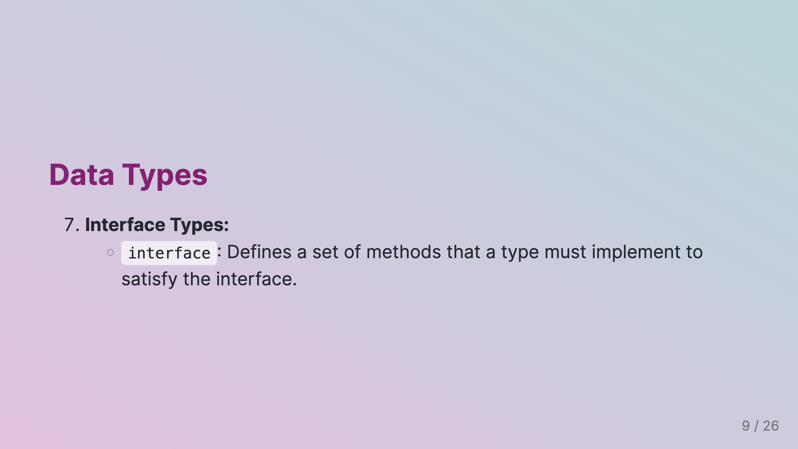

Slide 10
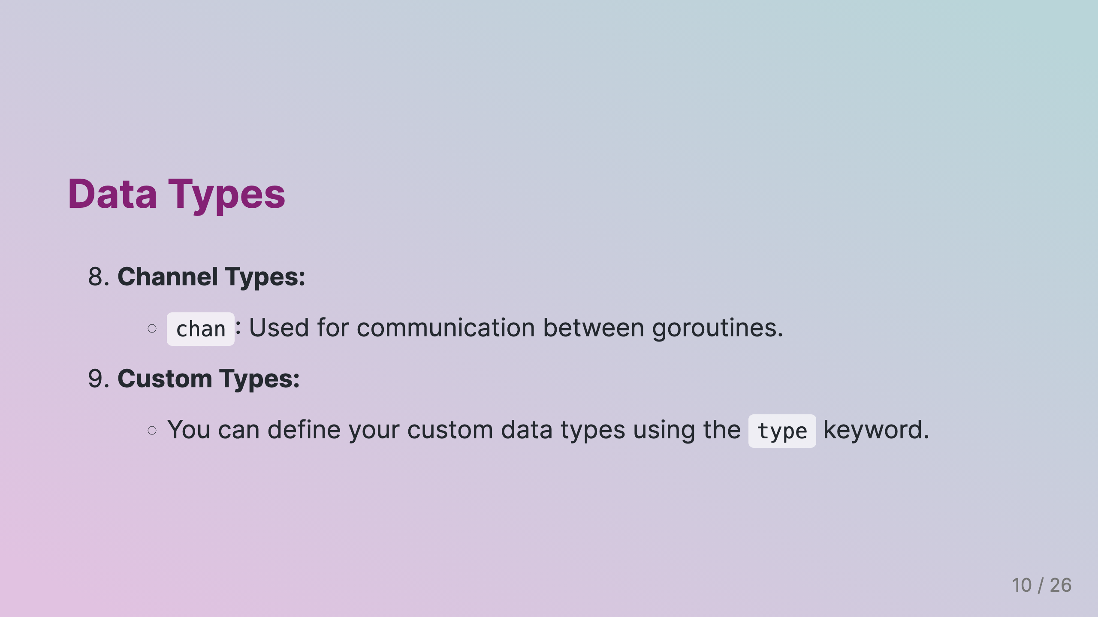

Slide 11
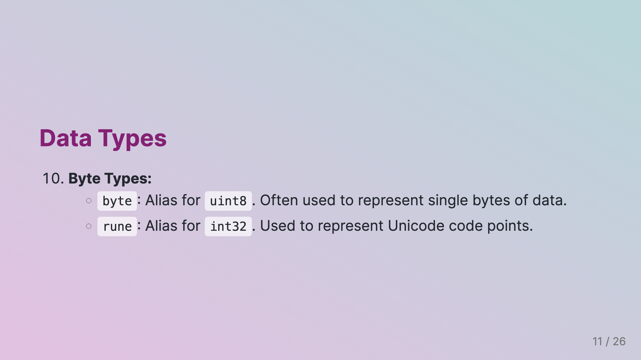

Slide 12
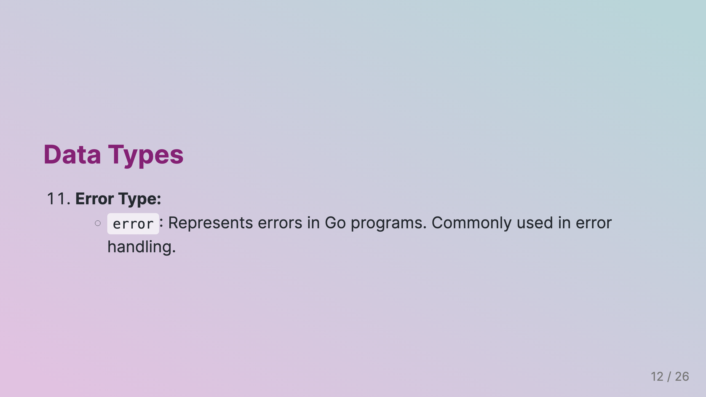

Slide 13
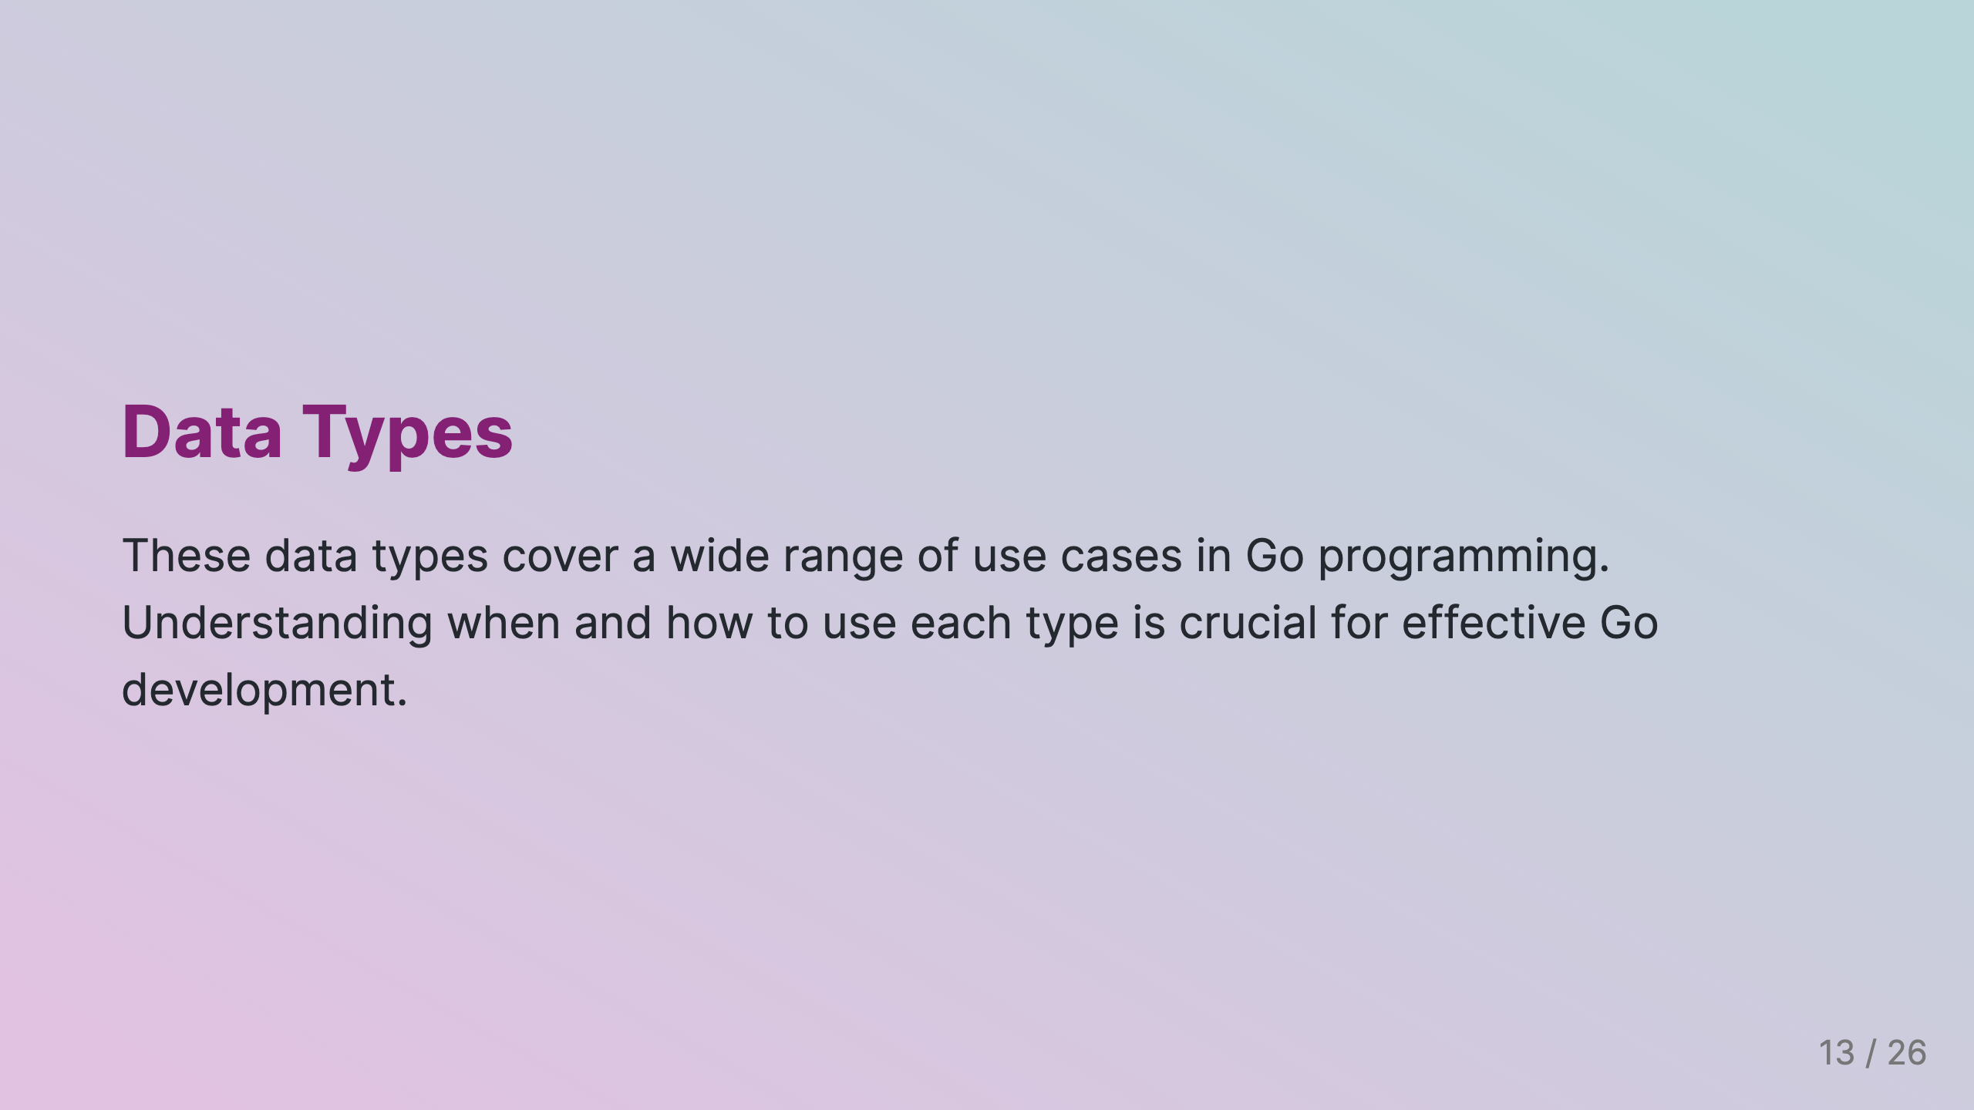

Slide 14
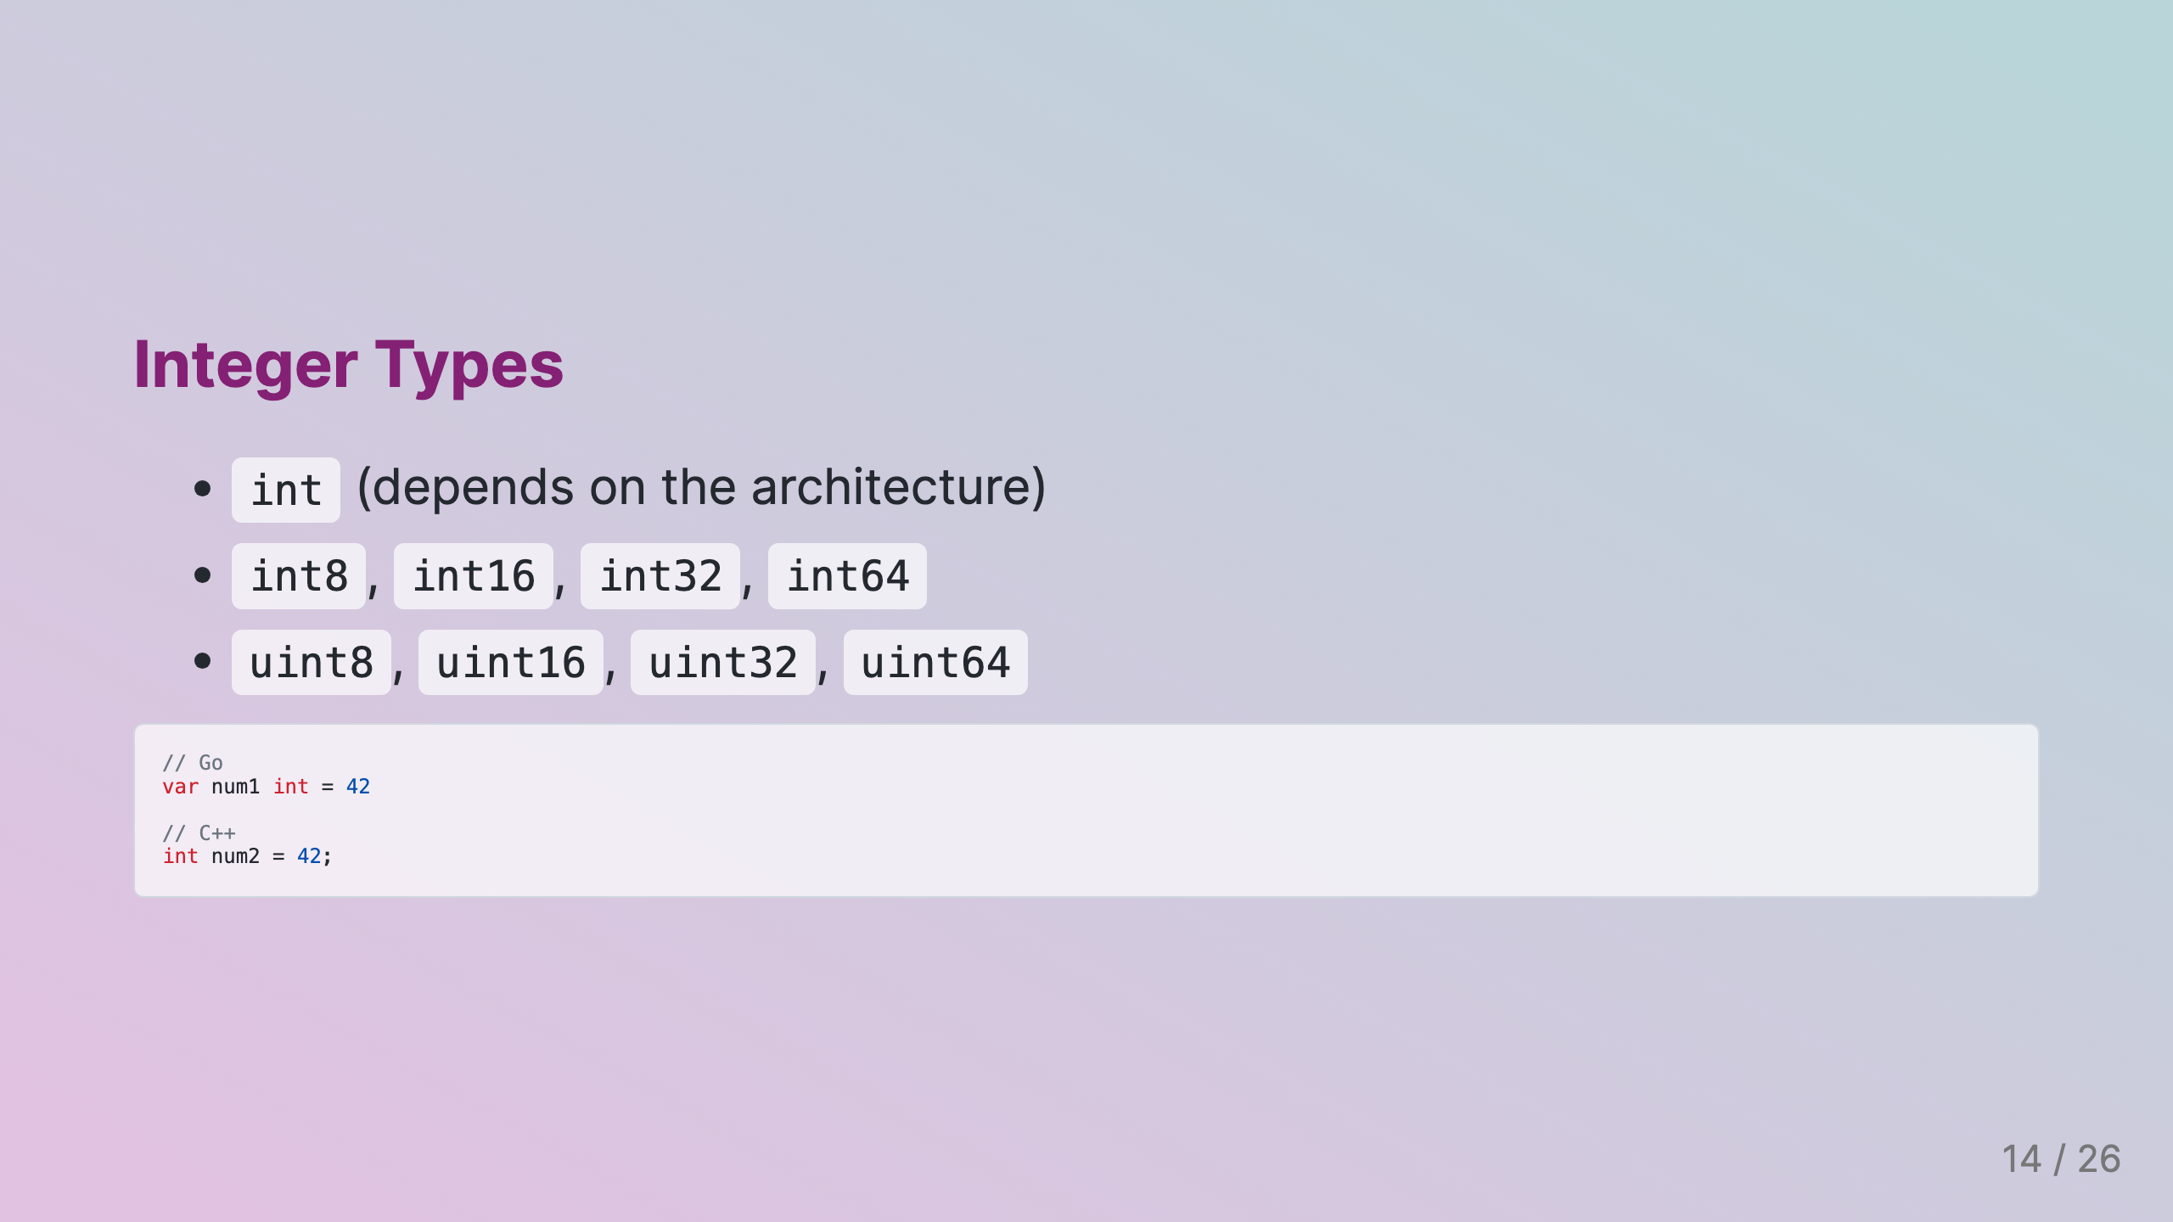

Slide 15


Slide 16
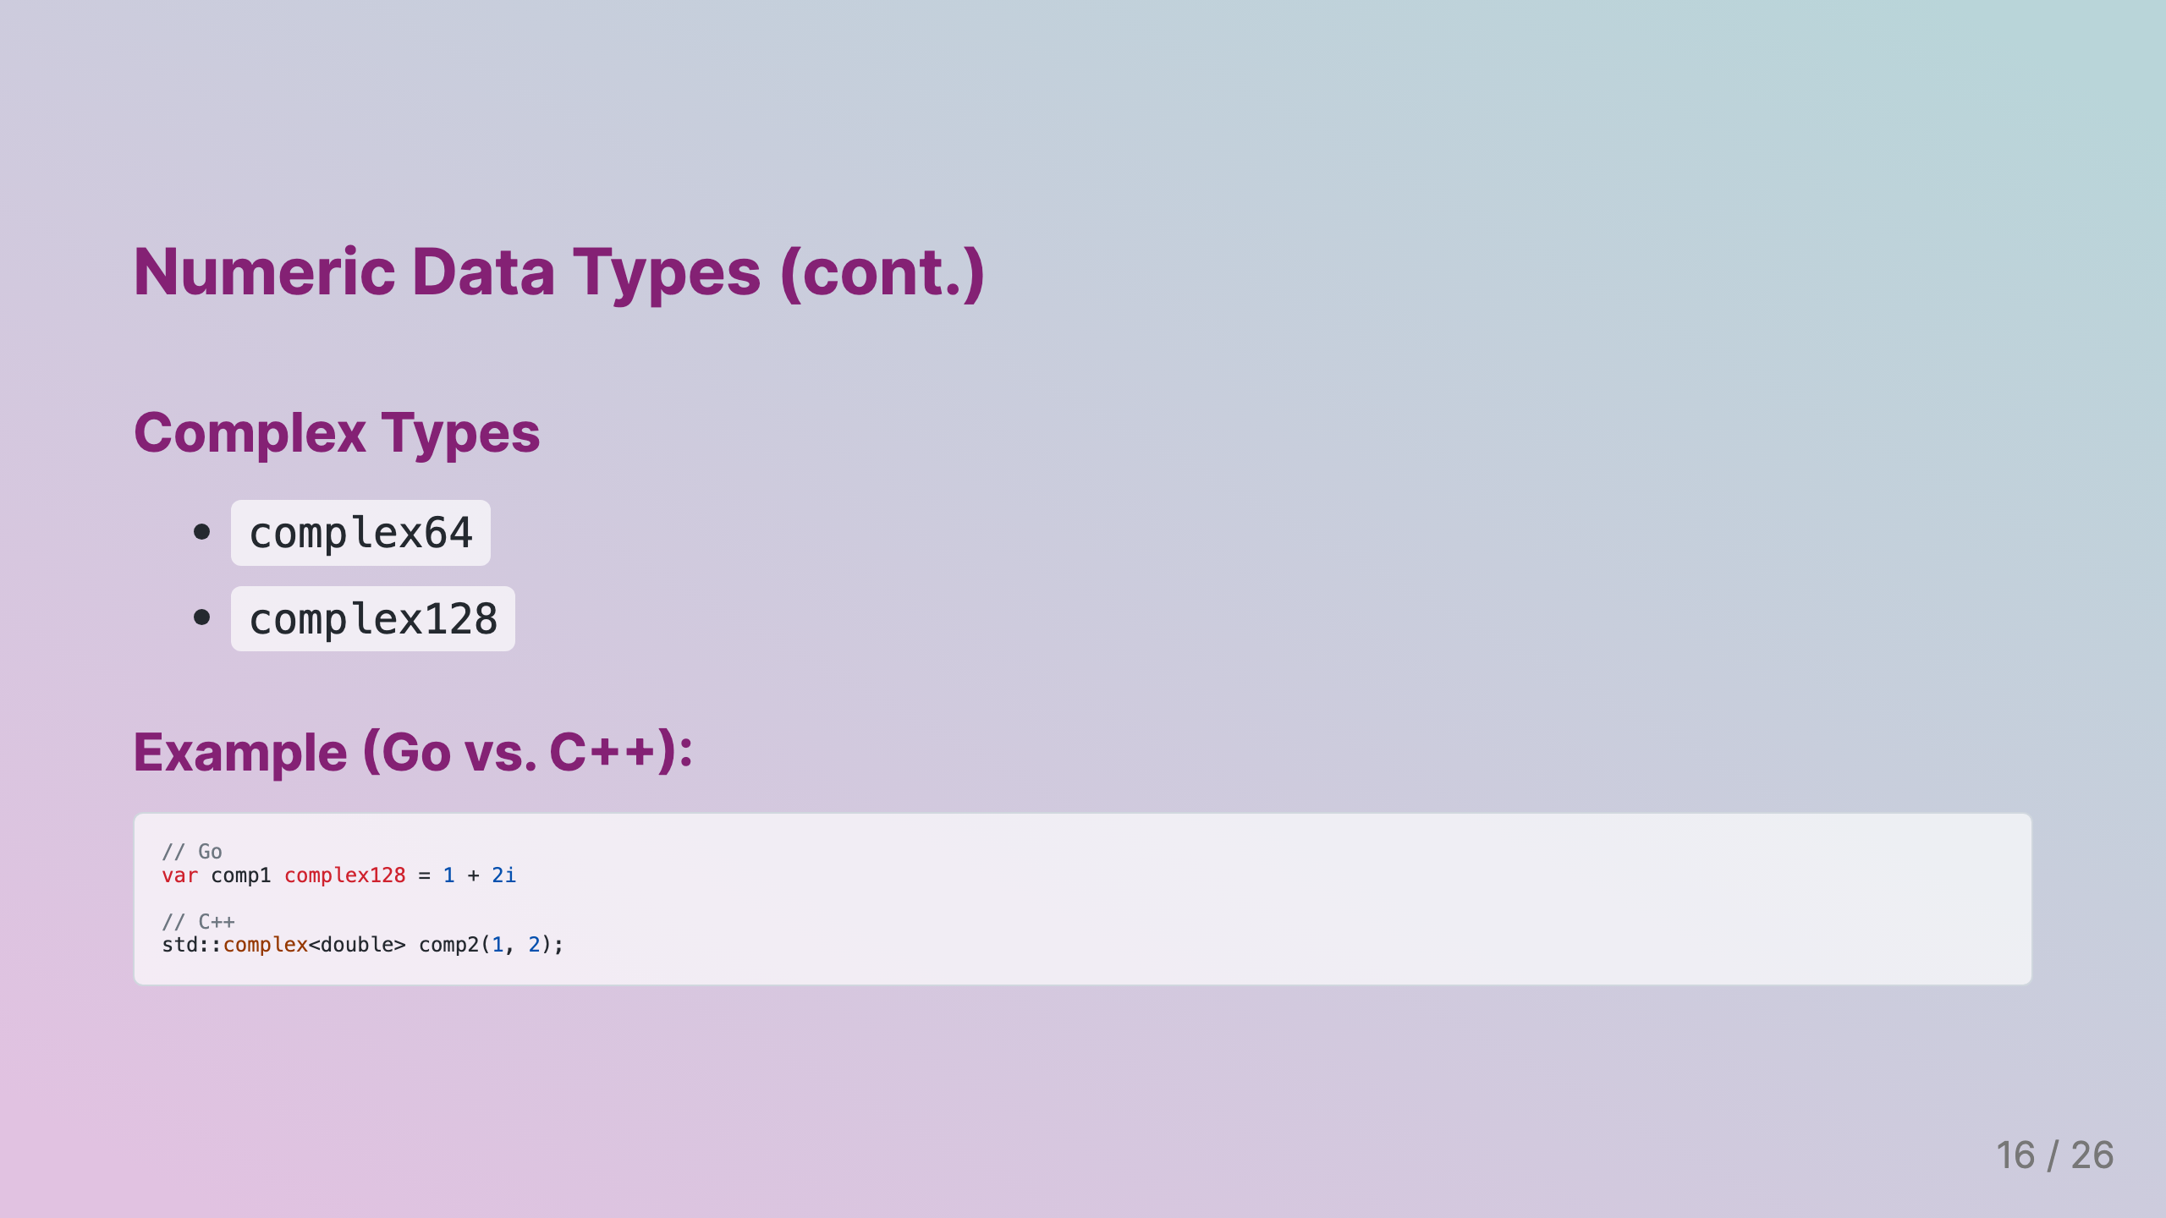
Notes:
Slide 4: Numeric Data Types (cont.)

Slide 17
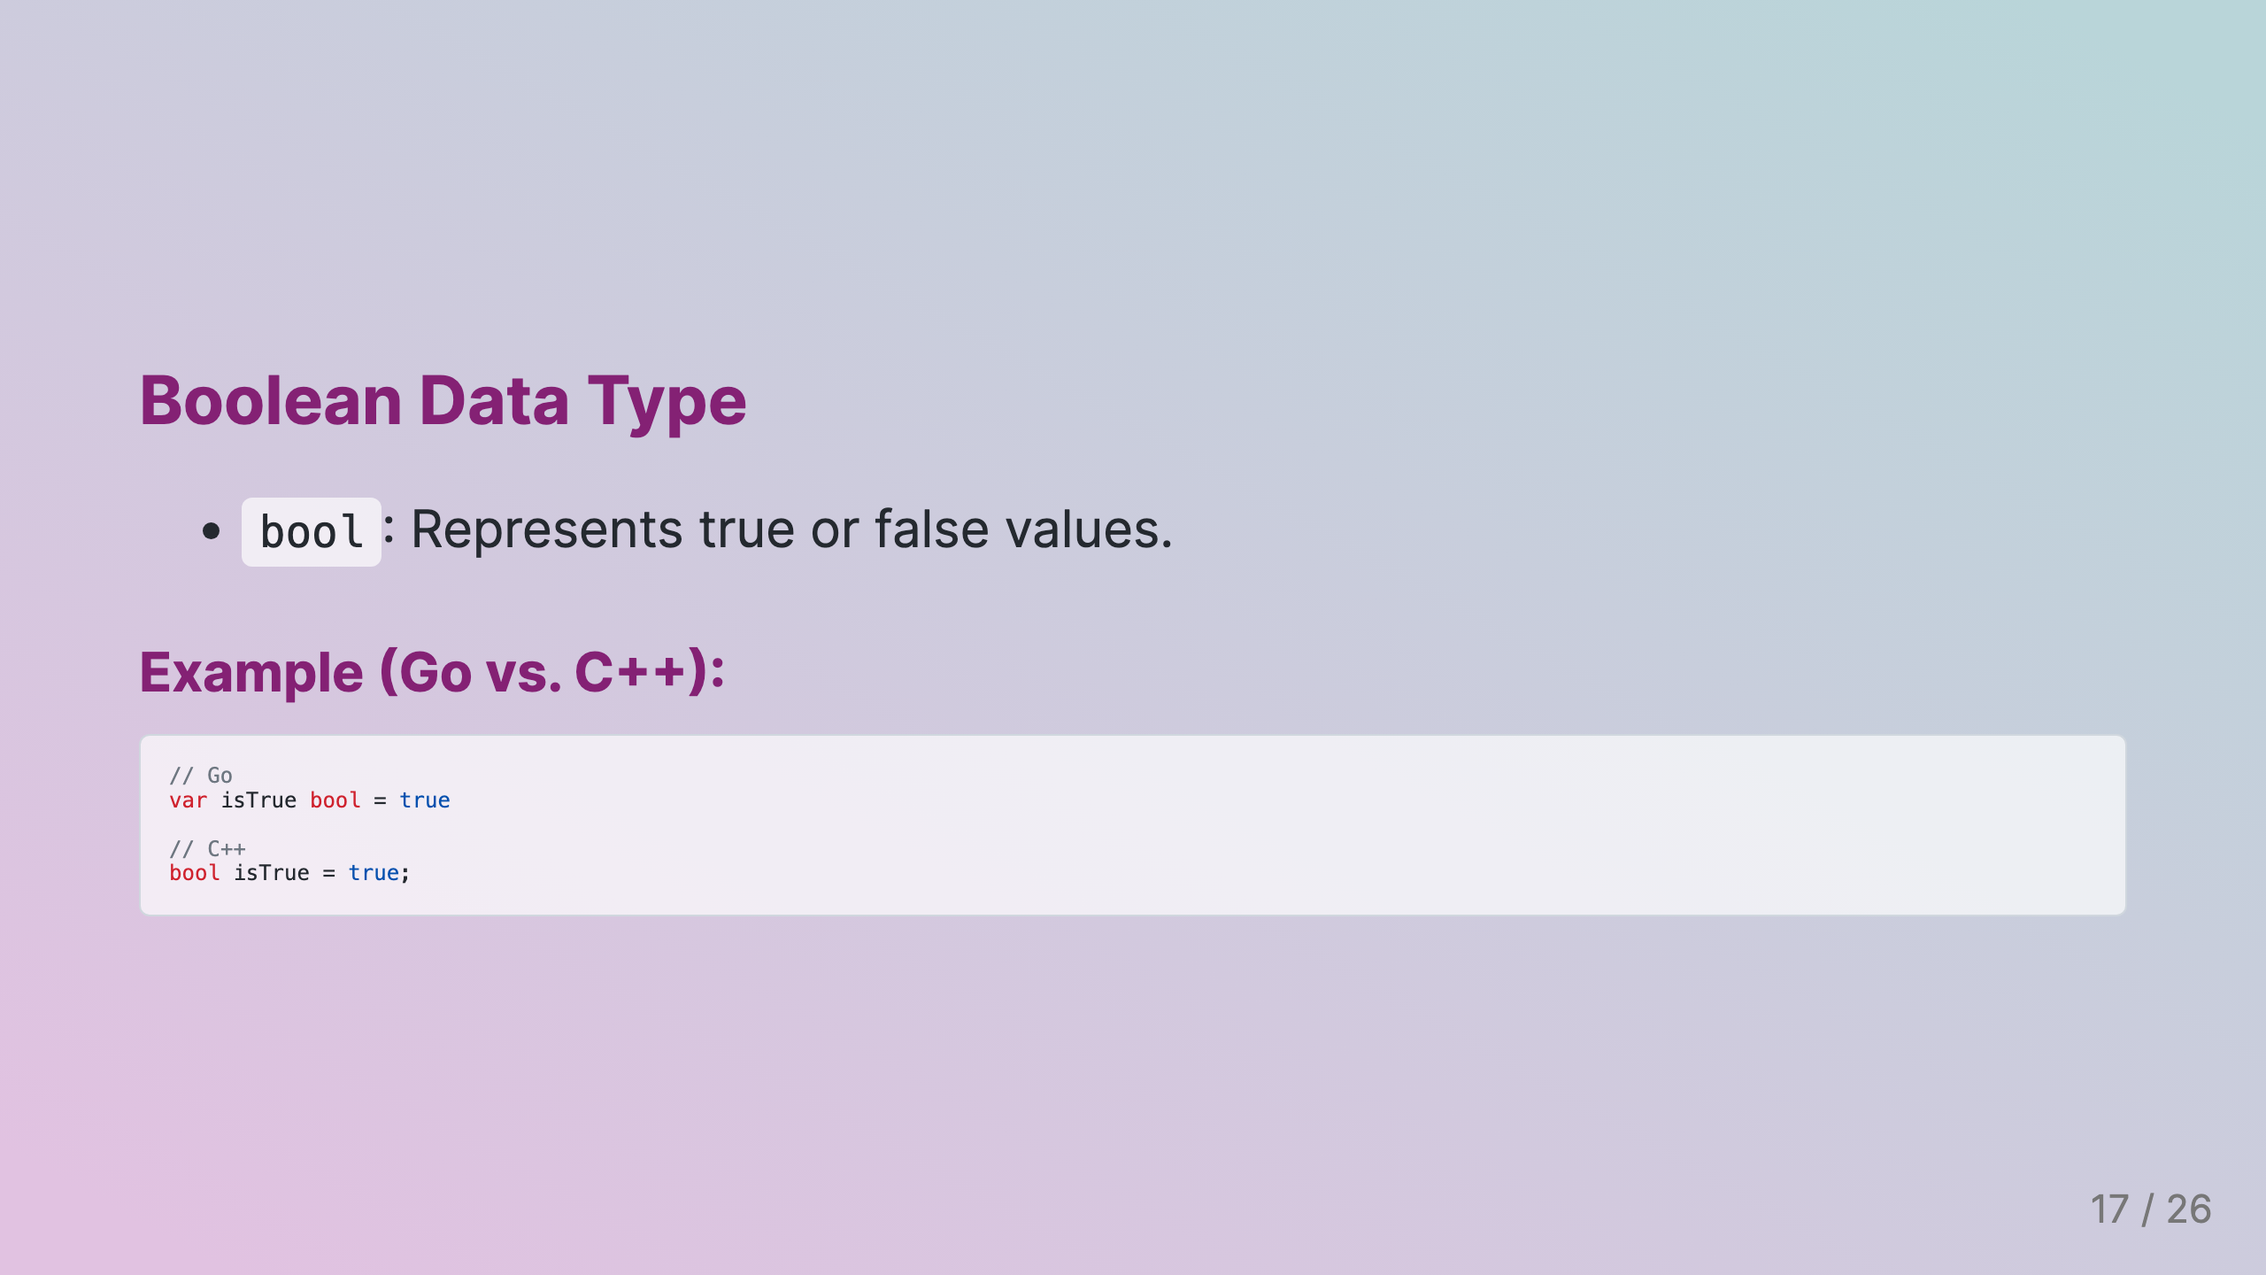
Notes:
Slide 5: Boolean Data Type

Slide 18
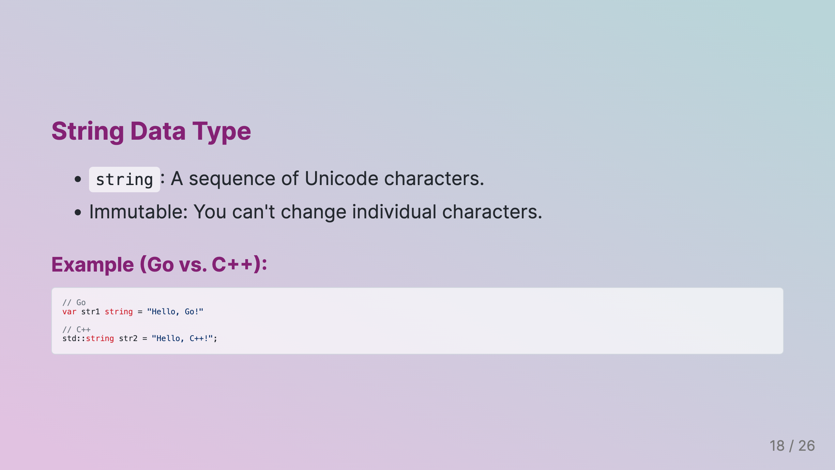
Notes:
Slide 6: String Data Type

Slide 19
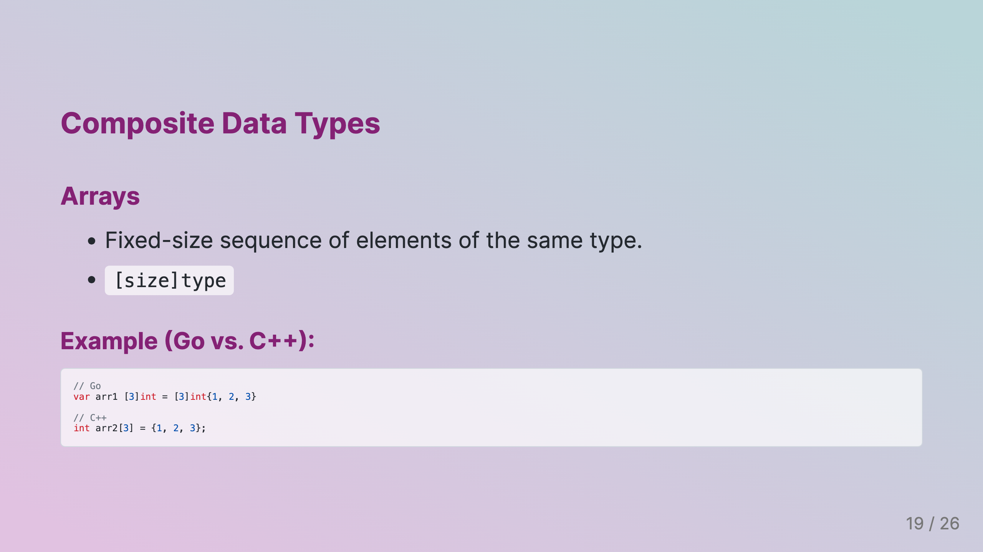
Notes:
Slide 7: Composite Data Types

Slide 20
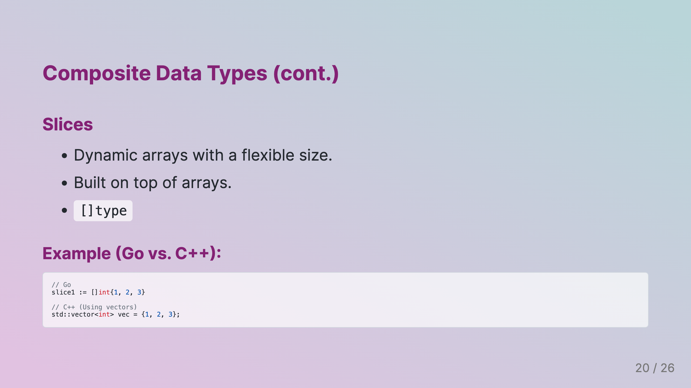
Notes:
Slide 8: Composite Data Types (cont.)

Slide 21
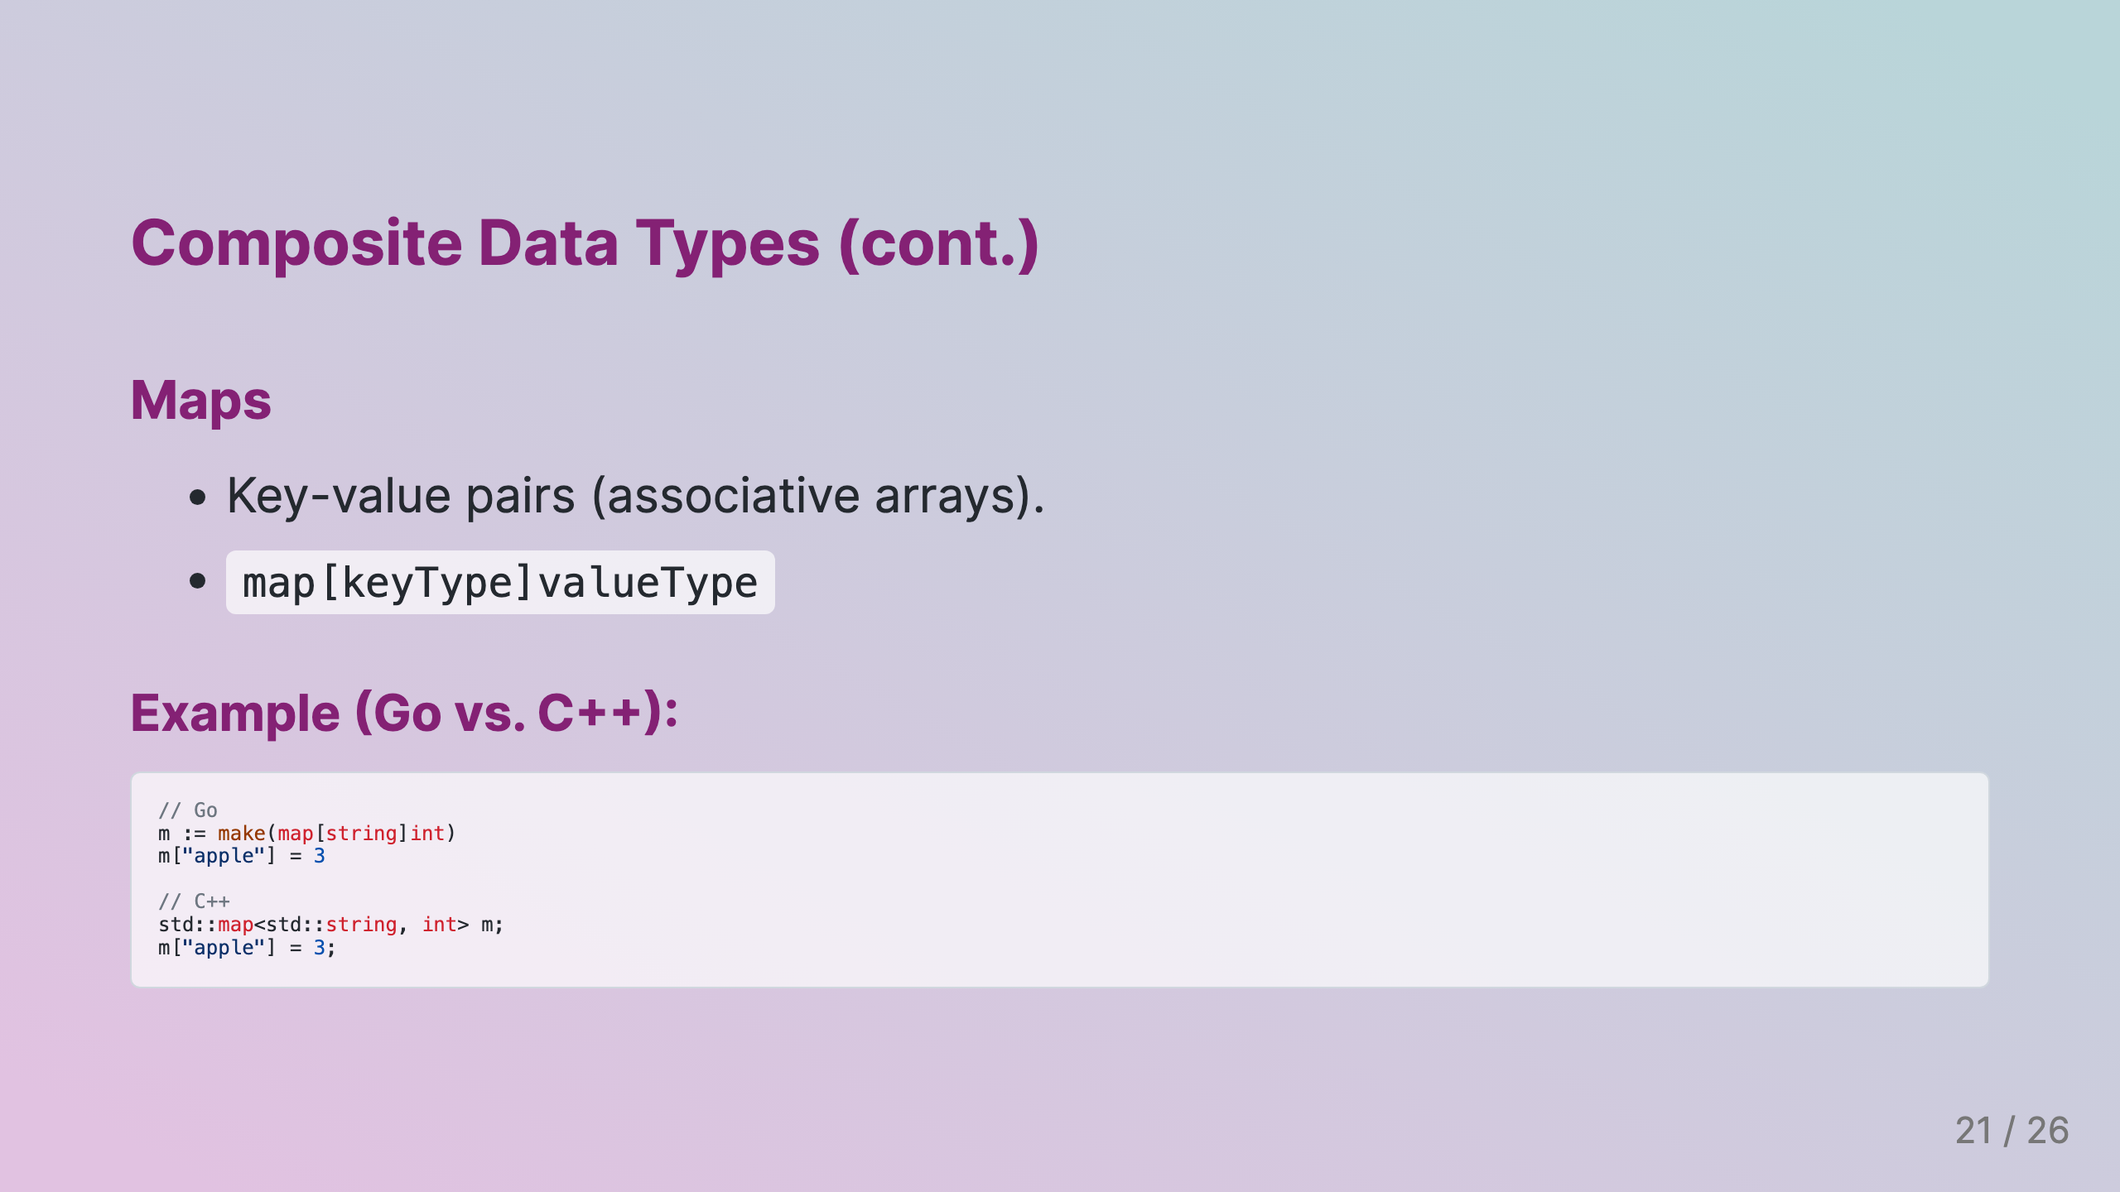
Notes:
Slide 9: Composite Data Types (cont.)

Slide 22
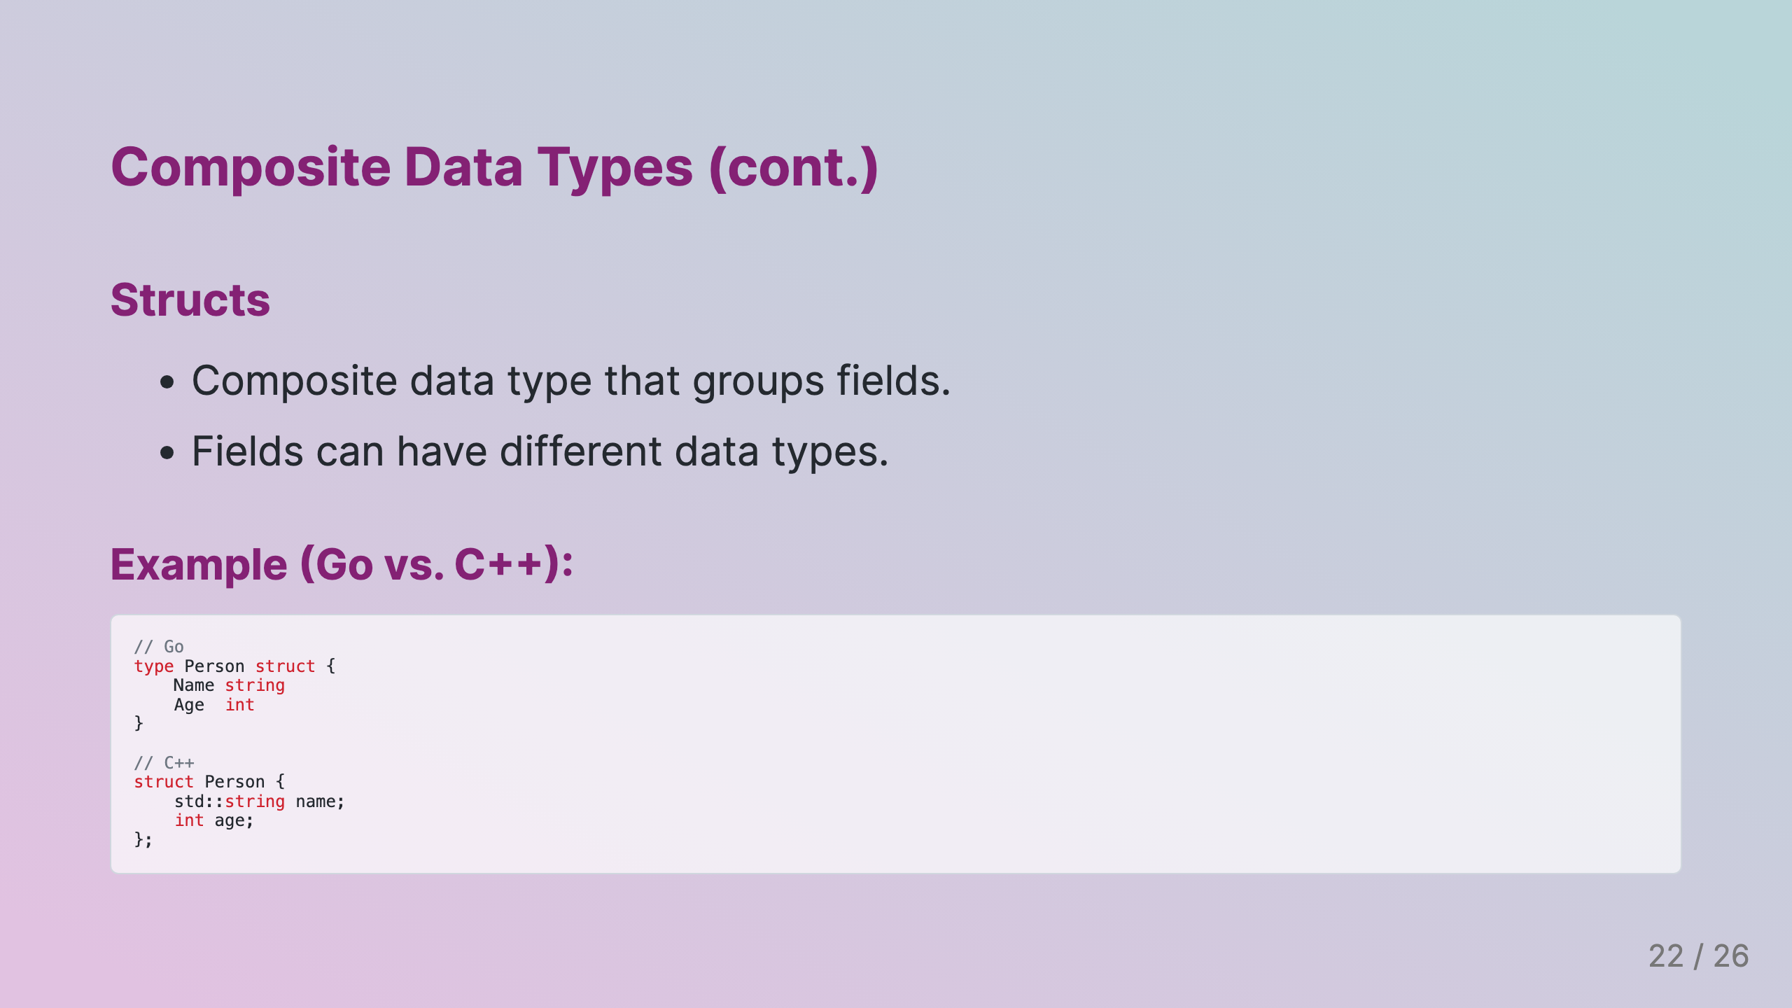
Notes:
Slide 10: Composite Data Types (cont.)

Slide 23

Notes:
Slide 11: Special Data Types

Slide 24
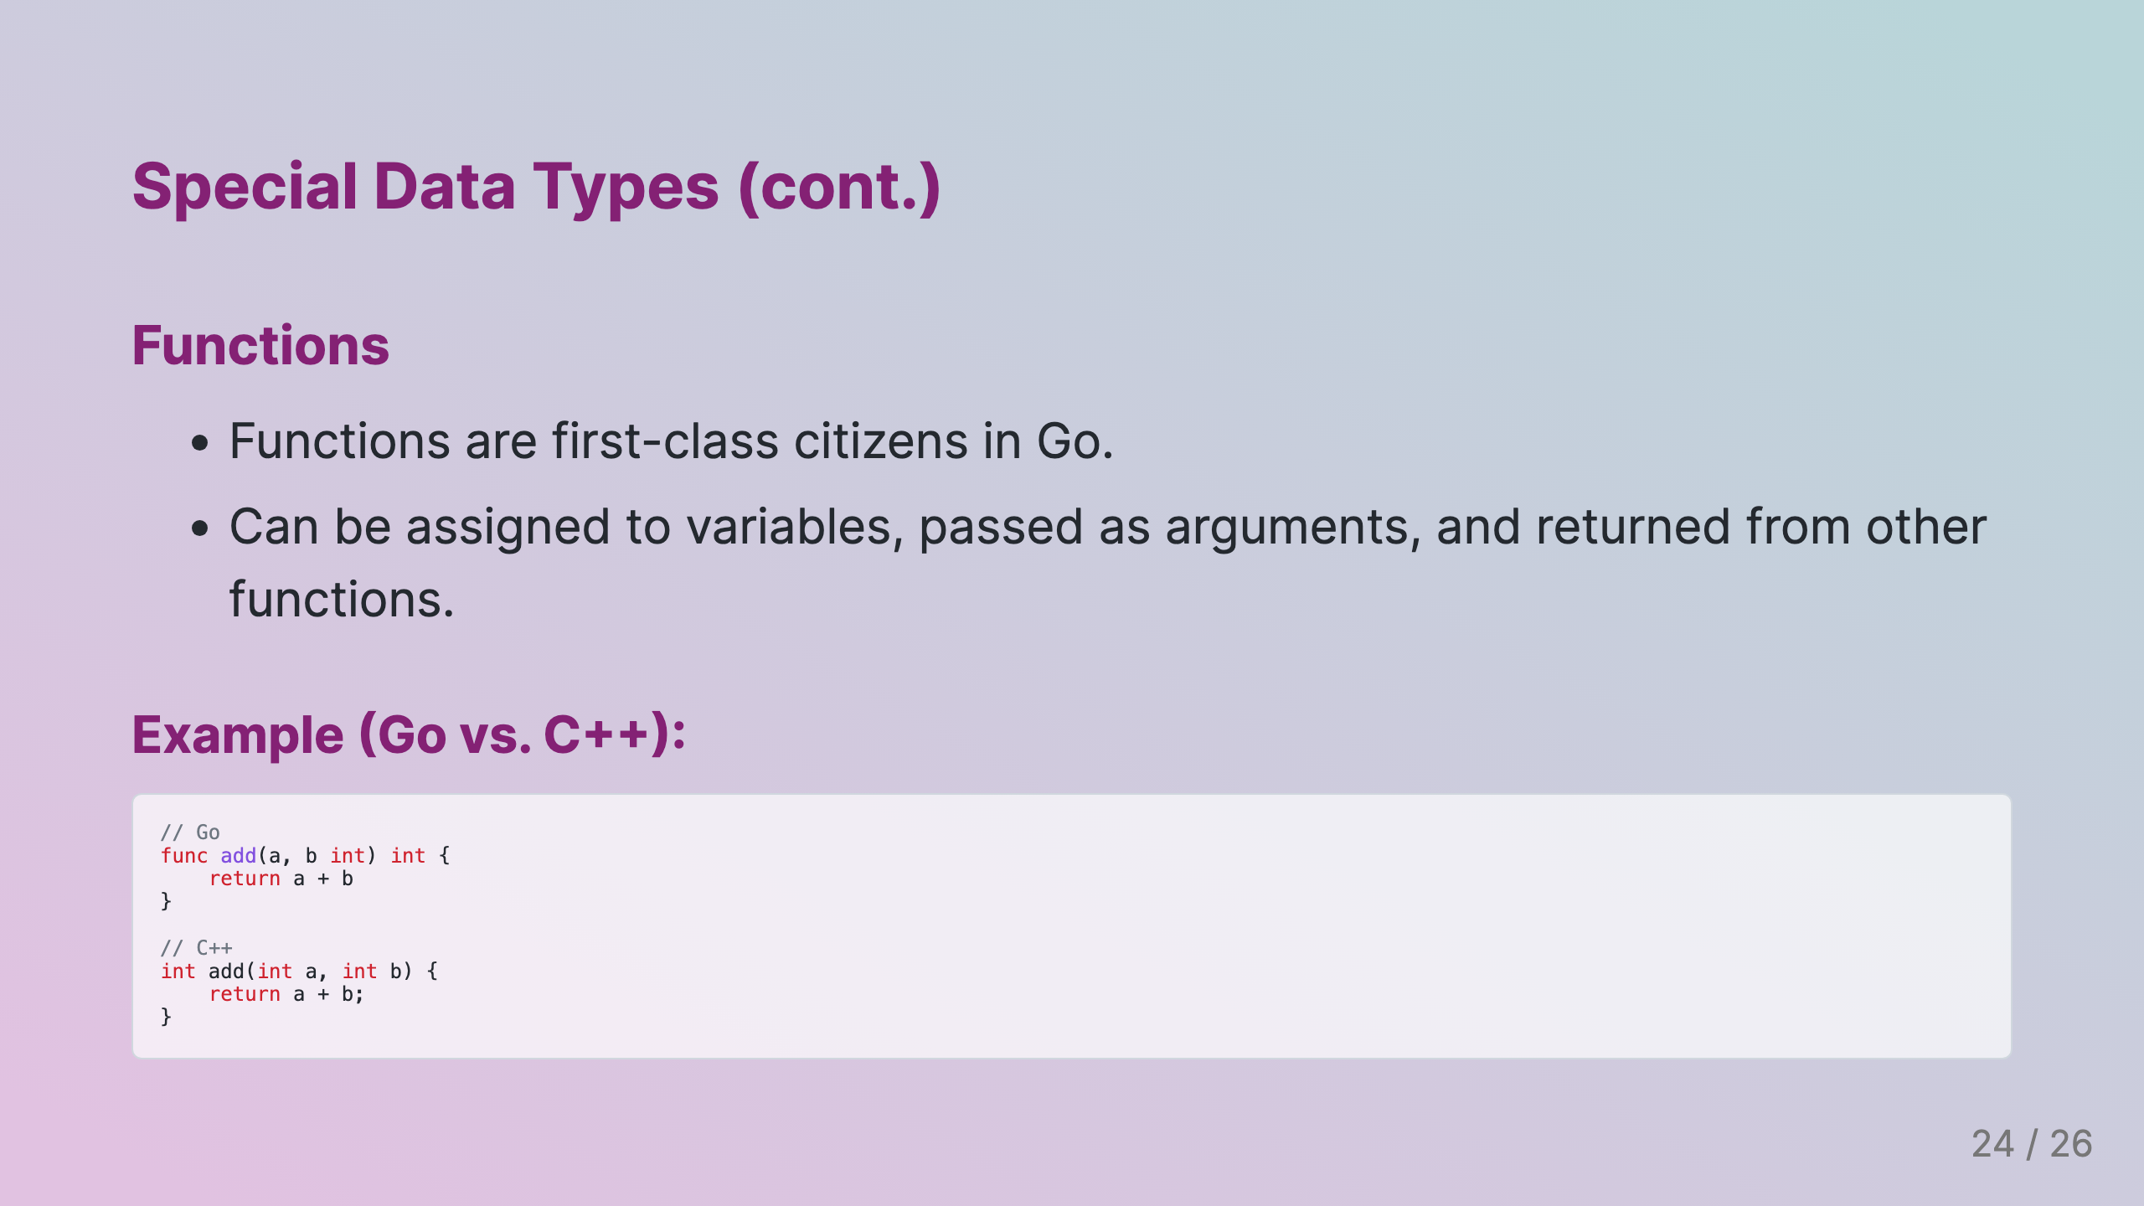
Notes:
Slide 12: Special Data Types (cont.)

Slide 25
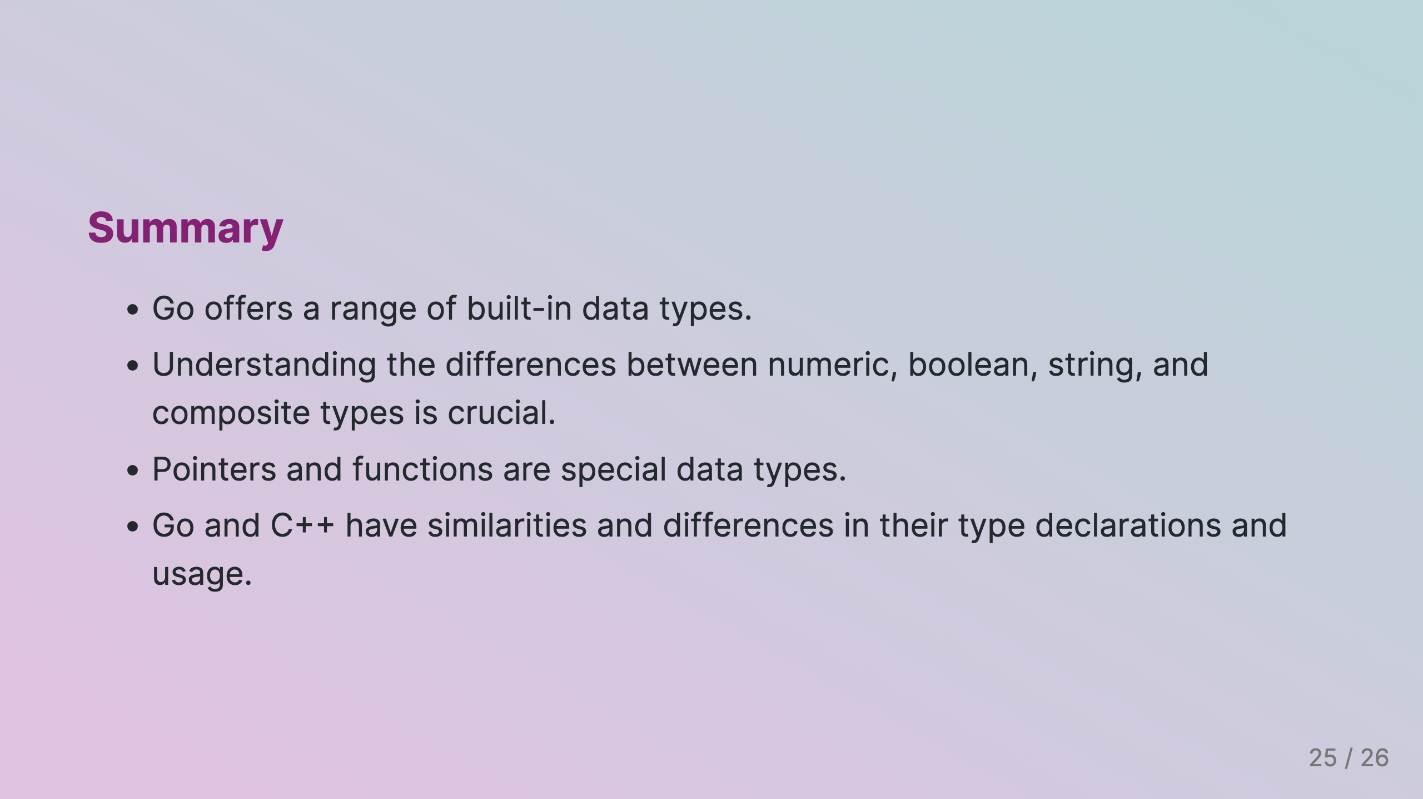
Notes:
Slide 13: Summary

Slide 26
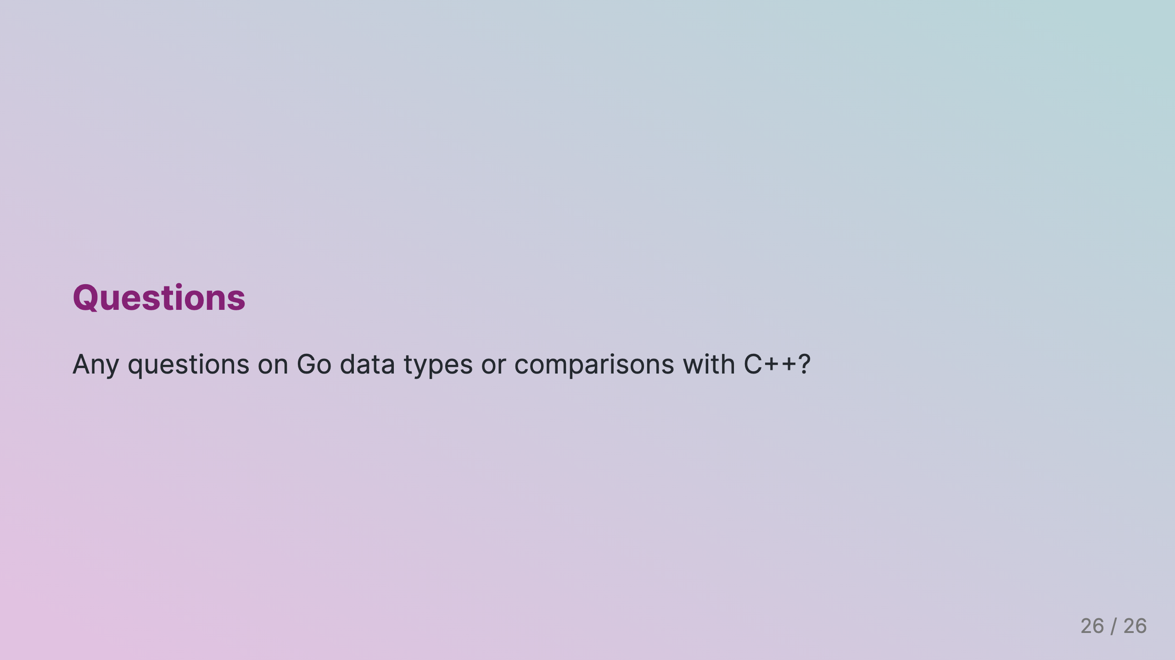
Notes:
Slide 14: Questions

